Slide 1
governance assessment project
Cesar Della Biancia
MSKCC
Todd Pawlicki
UC San Diego
AAPM Secretary

Slide 2
disclosures
None

Slide 3
Current aapm Structure
4 Councils
Administrative, Education, Professional, Science
Board of Directors and Executive Committee (EXCOM)
President-Elect, President, Chair of the Board, Treasurer, Secretary, Executive Director
EXCOM makes day-to-day decisions for the AAPM
Strategic Planning Committee (SPC)
Comprehensive review of the strategic plan
Evaluate progress towards achieving objectives
Notes:
The AAPM is a large and complex organization with an operating budget of about $10-11 Million per year.
The AAPM consists of 4 Councils and an executive committee (EXCOM) that runs the day-to-day operations of the AAPM with a lot of help from AAPM staff.
The AAPM also has strategic planning committee (SPC) that helps develop AAPM strategy as well as preforms a review of the strategic plan every 5 years or so and evaluates progress towards AAPM goals based on the strategy.

Slide 4
Courtesy of John Boone
Science
Council
(1972)
Professional
Council
(1973)
Education
Council
(1974)
Administration
Council
(2010)
Spring
Clinical
Meeting
First Annual Meeting
EXCOM Created
(1975)
ACMP
Professional Track
Education Track
Science Track
1958
2016
membership
$ Licensure
ABR requires
residency
CAMPEP
ABMP
SDAMPP
1960
1970
1980
1990
2000
2010
Notes:
And lastly, the AAPM is changing. This is a slide created by the most recent Chair of the AAPM Board, John Boone.
The AAPM started in 1958 shown on the left of the slide. The cone is an accurate representation of the growth of the AAPM membership each year. As you can see, the AAPM has grown in size as well as functionality over the years. Some efforts have been tremendously successful such as the Medical Physics Journal and some have evolved over time like the role of the American College of Medical Physics.
It is also interesting to note that the structure of the AAPM has evolved over time. The Board has increased in size as new chapters were added and the councils were introduced as the need arose; Science Council (1972), Professional Council (1973), Education Council (1974), EXCOM (1975), and the Administration Council (2010).

Slide 5
Governance as Leadership
Courtesy of Quantum Governance, L3C
Fiduciary Thought
Strategic Thought
Generative
Thought
Notes:
The governance assessment project was just an effort to look at the AAPM structure and say, “Could we be more effective if we were aligned in a different way?”
To do this assessment, the AAPM contracted with a company called Quantum Governance. Quantum is a company that specializes in good governance practices for non-profit organizations like the AAPM.
From Quantum, we learned that good governance requires three types of considerations from the board members. Fiduciary thoughts is making sure the AAPM is on good legal ground and financially responsible. Strategic thought is making decision about priorities and where to invest volunteer time and funds to achieve AAPM goals. The generative thought is the “out of the box” thinking about what the AAPM should be doing and what medical physics (and physicists) should be in the future.

Slide 6
Courtesy of Quantum Governance, L3C
What are the Core
Responsibilities
of a Nonprofit Board?
Governance
&
Leadership
CEO Support & Oversight
Performance & Results
Strategic Thinking, Learning & Planning
Budget
& Resources
Membership & Outreach
Stewardship Ethics & Financial Integrity
Notes:
The main responsibilities of a nonprofit board (or any board) are governance and leadership.
There are 6 aspects of governance and leadership:
Oversight and support of the executive director
Accountability to performance and results
Strategic thinking and planning
Allocation of budget and resources
Attention to membership and outreach efforts
Responsibility to ethics and financial integrity
We will describe these in a bit more detail in the coming slides.

Slide 7
Courtesy of Quantum Governance, L3C
The Exceptional Board
Exceptional
Responsible
Functional
Dysfunctional
Unconscious Conscious Enlightened
Notes:
There is a range categories that describe how effects boards are from unconscious to enlightened and from dysfunctional to exceptional. The dotted line in this figure indicates where the AAPM in currently functioning. [presenter’s note – this assessment comes from Quantum and is based on surveys of AAPM leadership and their own assessment and comparison to other similar professional societies.
Functional boards keep the organization running and ask questions like, “what should our society be doing?, what do our members need?”. In addition to this, responsible boards think about whether or not the society “is performing well enough to meet it’s strategic goals?, what changes need to be made to the strategic plan?”. The exceptional board also asks, “how is the board performing?, how can we create capable new board members?”.

Slide 8
How we got to this point
AAPM is a great organization
Governance assessment = Quality improvement
Important elements for this QI project
Quantum Governance, L3C consultants
Strategic Planning Committee (SPC) of the AAPM
Ad Hoc Committee on Governance Assessment (AHCGA)
TG281 Governance Assessment Communications Plan
Notes:
The AAPM is a great organization. It is widely recognized both nationally and internationally for high-volume, high-quality output of documents (Task Group Reports, MPPGs, etc.), as well as support of membership via the Annual and Spring Clinical Meetings that disseminate research and provide continuing education, running two impactful journals, supporting our chapters, and many other activities.
However, we could always do better. Therefore, the governance assessment project is really just a quality improvement project initiated by the board of directors. [Presenter’s note – the ideas always start with one or a few individuals but in order to move forward, those ideas must be approved by the board.] Nothing is broken with the AAPM per se but why shouldn’t we consider possible improvements just as we do in all other aspects of our professional lives.
As part of the governance quality improvement project, we had several groups participating (SPC, AHCGA, and the Board) as well as education and guidance from Quantum Governance. TG281 was created to disseminate information about the project and the governance recommendations leading up to the membership vote after the Annual meeting in Denver.
The committee have been meeting since 2015 on this project and have included the major stakeholders, e.g., councils, chapters, members, etc.

Slide 9
major AHCGA recommendations
Ensure the AAPM is led by its major member stakeholder groups
Clinical, Science, Chapters, Imaging, Therapy
New configuration of AAPM leadership
Create an operations group led by the President (EXCOM is no longer needed)
Reduce the size of the Board but consisting of major member stakeholders
New Council structure
Clinical Practice, Science, Regional Organization, Education, Member Services
Notes:
One recommendation was to ensure that the AAPM was led by it’s major stakeholder groups: the Chapters, Clinical, Science, Imaging, and Therapy.
It was suggested to create an operations group to run the day-to-day functions of the AAPM (with continued support of AAPM staff). The goal is to obviate the need for EXCOM to run AAPM operations. It was also suggested to create a more focused board of directors by focusing on the stakeholder groups.
Therefore, a new council structure was proposed that consists of: Science Council, Regional Organization Council, Education Council, Clinical Practice Council, and Member Services Council. We will discuss a bit about what each of these councils will do in the coming slides.

Slide 10
Board sizes & trends
http://www.blueavocado.org/content/whats-right-size-board
Notes:
BoardSource research shows that the average board is currently about 15 members. With boards of this size, it is really important to pay close attention to the composition of the board.
[Presenter’s note: BoardSource is a well-known company who’s mission is to inspire and support excellence in nonprofit governance and board and staff leadership.]

Slide 11
Membership recognition governance changes
Previous 2005 membership vote on governance changes
Results
60% ‘yes’ votes and 40% ‘no’ votes
67% ‘yes’ votes needed to carry an amendment to AAPM governance
64 additional ‘yes’ votes would have carried the amendment
Notes:
From the 2005 RSNA Board meeting minutes: "Reorganization of the Board: The recent By-laws amendment to reorganize the Board structure failed narrowly (60% for, 40% against with 67% require to carry the amendment; 64 additional aye votes of 1003 would have carried the amendment).“
Number of ballots = 1005 (944 electronic ballots, 61 paper ballots)

Slide 12
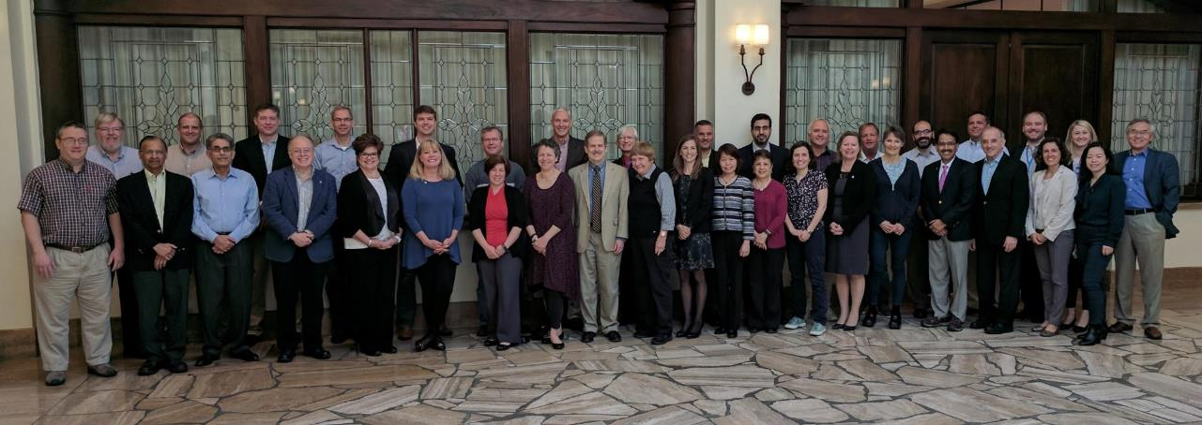
Current Governance Structure
Board of Directors
EXCOM
(reports to the Board)
N = 6
1
Executive Director
N = 49
(38 voting members)
5
Presidential Chain, Treasurer, Secretary
21
Chapter elected board member
12
Member-at-Large board member
10
Non-voting board member
Notes:
This is a schematic of the current AAPM structure. As previously mentioned, there is a fairly large board of directors consisting of 49 members, some voting and some non-voting. There is the presidential chain, executive director, chapter elected board members, members-at-large, and council chairs, etc.
In the current structure, EXCOM (consisting of 5 individuals) is running the day-to-day operations of the association.
There is also a finance committee to look after AAPM finances and the calibration laboratory accreditation executive committee that decides on accreditation matters of the ADCLs.
The current Board of Directors of the AAPM has 38 voting members and 11 non-voting members made up of members as described on the slide.
Board of Directors (49 members)
38 Voting Members
EXCOM (5) + 1 Member from each Chapter (21) + Members-at-large (12)
11 Non-voting Members
Council Chairs and Vice-Chairs (8) + ED (1) + AIP Rep (1) + Rules Committee Chair (1)

Slide 13
Proposed Governance Structure
Board of Directors
Operations Committee
(reports to the Board)
Science Council
Chair
Non-Member
(as Appt’d)
N = 11
Science
Council
Vice-Chair
Regional Org
Council
Chair
Treasurer
Regional Org
Council
Vice-Chair
Chair
N = 13
President
Education Council
Chair
Executive Director
(Non Voting)
Gov.
& Reg Affairs Committee
Chair
Immediate Past Chair
Education Council
Vice-Chair
President Elect
Clinical
Practice Council Chair
Clinical
Practice Council Vice-Chair
Secretary
Member
Services Council
Chair
Member
Services Council
Vice-Chair
Notes:
The proposed structure is much more streamlined where the board consists of up to 14 individuals and the only non-voting member is the executive director.
The operations group, on the other hand, has been expanded to include 11 members to run the day-to-day operations of the association. Previously, only 5 members (EXCOM) was responsible for this important function.
In the next slides, I will discuss the councils as well as the different roles on the board and the operations group.

Slide 14
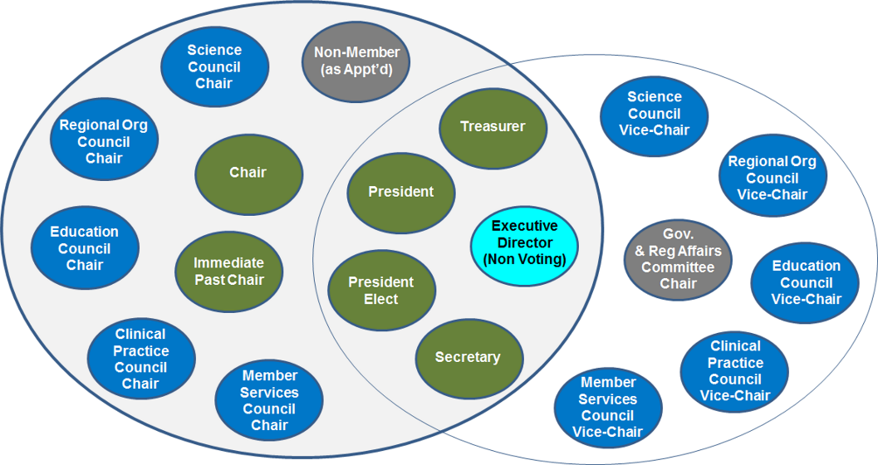
Clinical practice council
Stewardship of the profession of clinical medical physics
Accreditation and credentialing
Vendor relations
Practice guidelines
Regulatory and legislative affairs
Patient communications
Media response to clinical issues
Notes:
The Clinical Practice Council with economics related to clinical work, accreditation and credentialing at the individual and practice level, vendor relations, practice guidelines, clinical aspects of regulatory and legislative affairs, communication and value demonstration in the clinical environment, patient communications, and media response to clinical issues.

Slide 15
Member services council
Membership Committee
Publishing and e-presence
Journals Management
Meetings
Ethics
Awards & Honors
History
Notes:
Member Services Council has a broad range of delivering products to the members and addressing needs of the members; both current needs as well as anticipating future needs of the membership. It includes publishing our two journals, our meetings, awards and honors, and history.

Slide 16
education council
Maintains most of its current structure and charges
Oversees two committees for better coordination
International Educational Activities Committee
International Affairs Committee
Notes:
The Education Council is pretty much the same except for international affairs. We discovered that having international affairs both in administration council and education council led to a lot of confusion and conflicts on occasion. It was decided to combine the two of them under the Education Council because that is where most of the international work was focusing.

Slide 17
Regional organization council
The profession has not realized optimal value from a collaboration of AAPM with its Chapters
Ensures synergy and coordination of Chapter activities with AAPM’s more comprehensive efforts
Education, vendor support, regulatory, communication, cultivate AAPM leadership
Identifies Chapter needs, develops and maintains performance standards, and secures resources to achieve goals
Notes:
There was a recognition that our chapters are one of the greatest strengths of the AAPM but have not been adequately recognized or supported. Therefore, it was suggested to raise the chapters to the level of a Council that has a dedicated voice at the board level. The goal with this recommendation is that chapter activities would be more involved with the AAPM; defining education needs, supporting vendor interactions and funding, and in general foster a better cooperation with the chapters to support members through the chapters at the best possible level.
Elevated from a subcommittee (current) to a council (proposed)

Slide 18
science council
Generally consistent with current structure
Responds to press inquiries on scientific matters
Oversees scientifically-based policies and position papers
Administers most scientific TGs and WGs through TPC and IPC
Responsible for governmental aspects of research funding
Notes:
Science Council is pretty much the same except that activities related to research funding would fall exclusively under Science Council (as opposed to be partly shared with GRAC), which is how things have fallen in practice anyway. There are a number of other important functions that it will continue to perform such as responding to press inquiries on scientific matters, overseeing scientifically-based policies and position papers as well as administering scientific task groups and working groups through therapy physics committee and imaging physics committee.

Slide 19
non-member seat on the board
Purpose
Ensure expertise not typically obtainable through member appointments, e.g.: hospital administrator, legal, marketing, sales, non-profit revenue generation
Why make this a Board position?
Get best qualified person possible
Establish a long-term relationship for the benefit of AAPM and the profession
Not a required Board position, only filled as the Board deems necessary
Notes:
The goal is include someone that has special skills that could benefit the AAPM in strategic decisions or other board-type functions. For example, if we were really interested in fund raising, we might recruit a CEO from another society that is successful in fund raising to sit on the board. There are many other skills that might be needed in the future such as a lawyer (legal), hospital administrator, technology business executive, etc. The reason that we would give them a seat on the board is to ensue that we get meaningful and on-going input, which is very different than hiring a consultant to give advice.
This board seat would not have to be filled but would only be filled as the board deems necessary. The non-member (voting) position is elected by the Board for two year term, can be reappointed for multiple terms.

Slide 20
Other Ahcga recommendations
Create a new Governance Committee
Tasked to develop and ensure governance skills of board members and diversity
Chaired by the Secretary
Board members need to be elected by General Membership
Vice-chairs succeed to council chair (Board) after two-year term
Executive Director and non-member director are appointed by the board
Notes:
All of the board members (except for the non-AAPM member and the Executive Director) are elected by the general membership.
A newly created Governance Committee (chaired by the AAPM secretary) and has the responsibility of developing new board members. This is something that really doesn’t happen now. A much better collaboration with the chapters could be created to develop leadership skills of the members at the chapter level that would then make them ideally suited to serve on the AAPM Board of Directors.
Other responsibilities of the Governance Committee are to write job descriptions of the different board positions, ensuring diversity of the AAPM Board, and reviewing metrics and helping the board improve its performance related to governing the association.

Slide 21
Duration of Service
Pres-Elect
President
Chair
Past Chair
1 year terms
Secretary
Secretary
2 year terms
Treasurer
Treasurer
2 year terms
Councils
Operations
Committee
Board of
Directors
Vice Chair
Chair
2 year terms
Notes:
Nominees for Board and Operations Committee are selected by the Nominating Subcommittee under the Governance Committee of the Board
Presidential Chain is 4 one-year terms
Secretary and Treasurer are two year terms, two terms maximum and both can run unopposed for second term if desired
Council Vice-chairs are elected and serve ex officio on the Operations Committee for a two year term, then succeed to Council Chair as a member of the Board
Executive Director (non-voting) is appointed by the Board, serves ex officio on the Board while in that position.
Nominations Committee
Select among the Board-ready AAPM members for the General Membership vote
Operations Committee
Reports to the Board
Implements the Strategic Decisions of the Board
Responsible for Operational Aspects of the AAPM
Chaired by the President of the AAPM

Slide 22
Steps leading to successful change
communication with members
March 2017
July 2017
September 2017
Board vote at Spring Clinical Meeting
Proposed at Annual Business Meeting
Member Vote
Implement Transition Plan
Board members vote on changes to the Bylaws that reflect these changes.
Proposal and Member discussion at the Annual Business Meeting.
Notes:
This is the timeline of where we site now. The Board has just approved the Bylaws changes that reflect the structure described in this presentation. The next steps is to discuss this at the business meeting in conjunction with the Annual AAPM meeting in Denver. After that, comments from the attendees at the business meeting will be collated and distributed and the membership will vote on the Bylaws changes. If successful, then the changes will be implemented to start on January 1, 2018.
[Presenter’s note – we don’t have the transition plan completely worked out just yet because of the amount of work required. For example, Rules Committee will meet to create the new rules reflected in the Bylaws, Board seat transitions will be figured out, etc.].

Slide 23
benefits of the changes
More effective governance and use of AAPM resources
Focus of the Operations Committee
Better distributed workload
Day-to-day activities from EXCOM (= 5) to new Operations Committee (= 11)
Member Services Council
Increased focus on and recognition of member satisfaction
Regional Organization Council
Increased focus on chapters
Notes:
The next two slides describe some of the benefits of the new governance structure.
We believe that the new governance will result in a more effective use of AAPM resources by dividing the strategy and operations between two groups; the Board and the Operations Committee. The day-to-day workload will be better disseminated with more people on the Operations Committee than on EXCOM. The Member Service Council will result in an increased focus and recognition on member needs and overall satisfaction. The Regional Organization Council will increase focus on the chapters – in the current structure, each chapter has only about a 2% weight on Board votes (1/39) and the new structure, needs of the chapters will have almost a 10% weight in Board votes (1/11). Furthermore, the chair of the Regional Organization Council will be charged with focusing creating improvements for all chapters.

Slide 24
benefits of the changes
Enhanced communication with members
New structure supports less layers (e.g., no EXCOM)
Sharp focus on strategic planning
Responsibility rests with the Board (e.g., no Strategic Planning Committee)
Governance Committee
Develop diversity and competency so that leadership positions are available to everyone
New structure is aligned with best governance practices
New councils are better aligned with what members want
Notes:
With EXCOM no longer needed in the new structure, there will be less layers and hence better communication with membership. Strategic planning will be embedded in the Board activities, not outsourced to the Strategic Planning Committee, which should result in improved on-going focus on AAPM strategy and monitoring whether or not the AAPM is achieving strategic goals. The Governance Committee will ensure a steady stream of qualified Board members as well as ensuring Board diversity and assessing Board performance. The new structure is aligned with current good governance practices for non-profit organizations and lastly, the new councils are more aligned with members’ need both today and in the future.

Slide 25
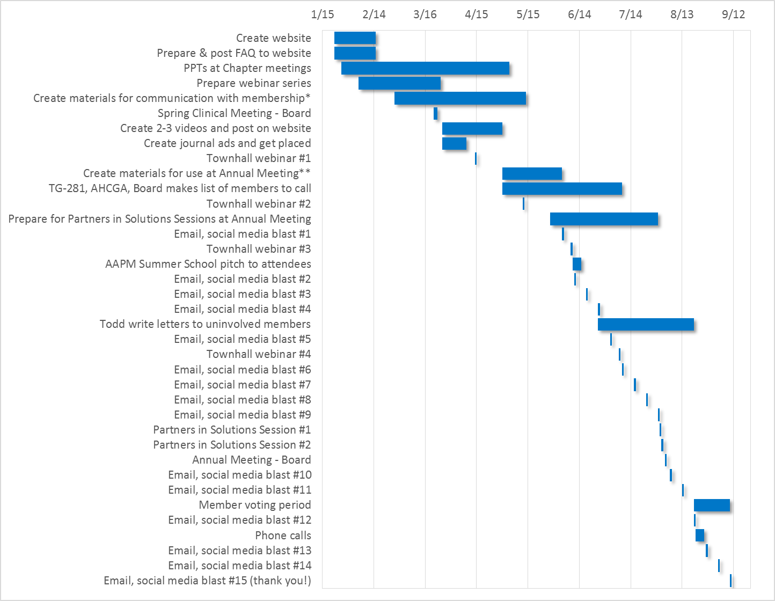
Communication strategy
Two Question Survey

Slide 26
summary
New governance structure: Simplified, Strategic, & Responsive

Slide 27
Acknowledgements
TG-281 Governance Assessment Communications Plan
Ad Hoc Committee on Governance Assessment
Strategic Planning Committee of the Board
Board of Directors
Rules Committee

Slide 28
Questions & Discussion

