Slide 1
EVOLUTION OF BRACHYTHERAPY
PAST AND PRESENT
BASIL S. HILARIS, MD, FACR
PROFESSOR EMERITUS
NEW YORK MEDICAL COLLEGE
RAMPS MEETING
MAY 15, 2012
Notes:
I would like to thank the Radiological and Medical Physics Society of New York
and especially Dr Albert Sabbas
for giving me the opportunity to be with you

Slide 2
TWILIGHT OF THE 19TH CENTURY
Physics advances and the discovery of radium
Europe at the end of the 19th century was at peace, enjoying an unprecedented prosperity. This made possible a remarkable flowering of arts and sciences.
In 1895, W.C. Roentgen discovered a new kind of radiation.
In 1896, A. H. Becquerel discovered natural radioactivity.
In 1898 the Curies for the first time produced polonium, and soon afterwards radium.
These four scientists were rewarded with some of the first Nobel prizes for their discoveries.
Notes:
Europe at the end of the 19th century

Slide 3
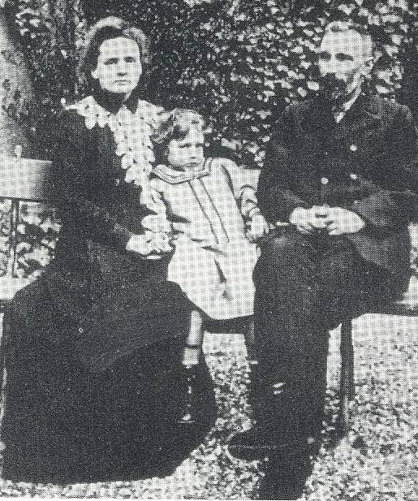
DISCOVERY OF RADIOACTIVITY
Few days are so significant as
December 26, 1898
  The day that Marie Curie stated at the French Academy of Science that:
  “ The object of the present work is the announcement of research which I have been carrying on for more than four years on radioactive bodies, which demonstrated that a new element strongly radioactive, that is radium, exists.”
The Curies
(Pierre, Marie and Irene)

Slide 4
RATE OF KNOWLEDGE
IN MODERN HUMAN HISTORY
Modern scientific and technological innovations go through cycles, that include:
  Initial discovery
  Development-Consolidation
Commercialization
Decline and replacement
This concept will help to understand
Brachytherapy’s development and evolution.
Notes:
Scientific discoveries get people very excited
and very soon are brought to common use
by physicists and engineers.
Modern innovations go through cycles … READ SLIDE…

Slide 5
CYCLE ONE (1900-1950)
Early attempts of brachytherapy
The discovery of radium opened the door for a whole new way of treating cancer and the development of a new specialty. It was Forssell’s destiny in 1931 to become the godfather of this new specialty and name it Brachytherapy.
The basic foundations of brachytherapy were established during this first period.
Notes:
Cycle one covers the first 50 years of the 20th century,
starting with the exciting discovery of radium
and continuing with its adaptation for
use in treating cancer..

Slide 6
HIGHLIGHTS OF CYCLE ONE
Radium therapy Centers were established throughout Europe and North America to treat cancer.
Radium techniques were developed for surface, interstitial and intracavitary radiation.
Dosage systems were proposed and tested to calculate radiation within the tumor.
The role model for brachytherapy was mainly in gynecology, head & neck, and skin cancer
Radium price skyrocketed from $10,000 in 1904 to $135,000 in 1918.

Slide 7
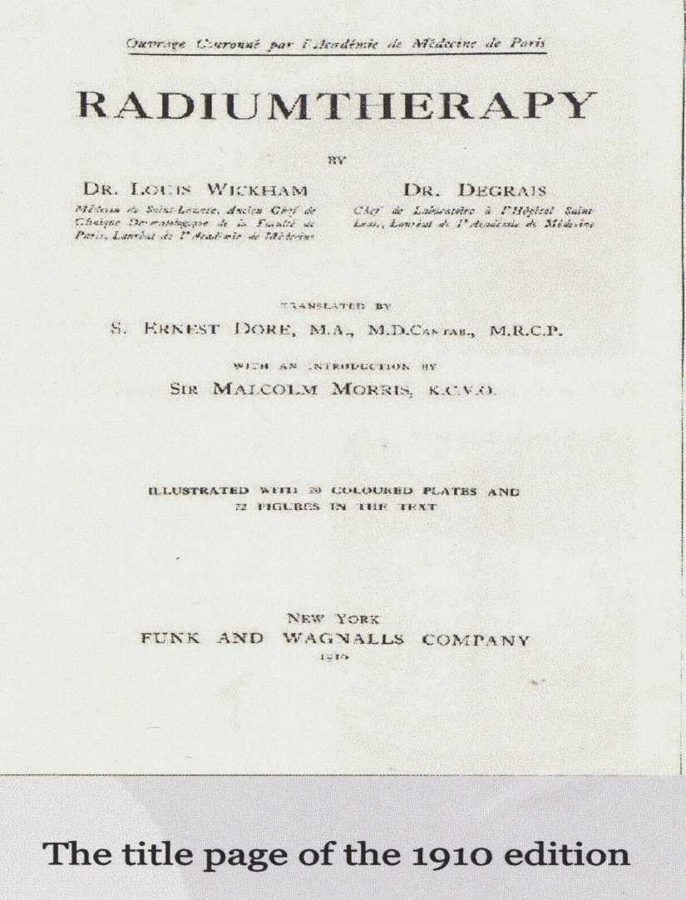
1906-BIOLOGICAL LABORATORY OF RADIUM OF PARIS
The first “Radium Institute” in the world was founded by L. Wickham (1861-1913) and P. Degrais(1874-1942) with Henri Dominici (1867-1919), as the first clinical director. They perfected the techniques and dosimetry of radium especially in cancer of the cervix; demonstrated the different biological effects of the various qualities of radium; initiated filtration; and introduced the principle of cross-firing.
The Laboratory closed in early 1914, in the beginning of WWI.
Notes:
The first radium Institute in the world
was founded in 1906 by two Parisian physicians, Wickam and Degrais.
They perfected the techniques and dosimetry of radium especially for intracavitary applications
in cancer of the cervix as it is shown in the photo on the left.
The results of treatment were presented in 1910.

Slide 8
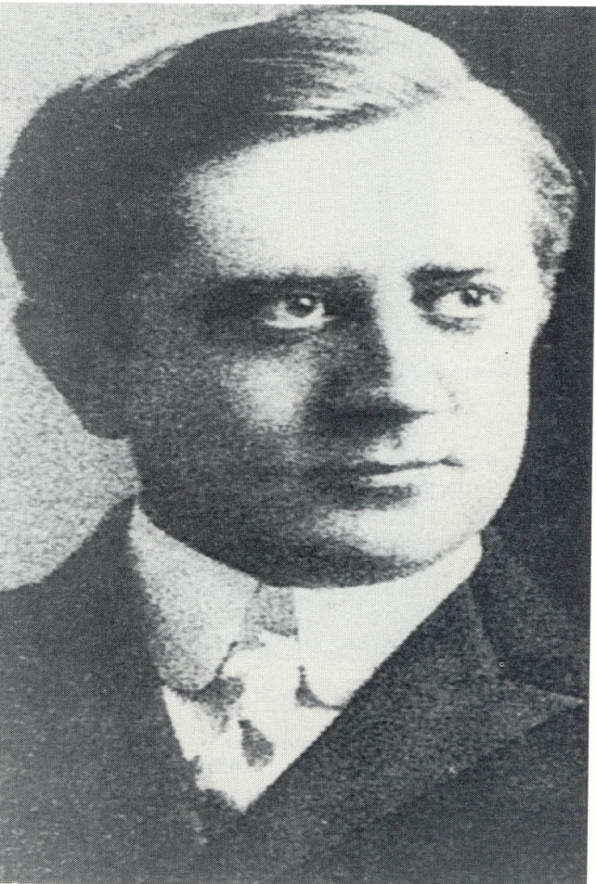
1910-RADIUMHEMMET IN STOCKHOLM
(Literally “Radium Home”)
The Stockholm school founded by G. Forssell, (E. Berven, J. Heyman, M. Strandqvist, R. Sievert, R. Thoraeus),
made significant contributions:
Treatment of cancer of the uterus (Stockholm technique);
Time-dose fractionation ( Strandqvist curve);
Radiation protection issues (Sievert chamber; Thoraeus x-ray filter, Free-air ionization chamber, etc)
In 1979, the unit of equivalent dose was named after Sievert (Sv).
Dr Gosta Forssell (around 1910)
1876-1950
Notes:
In 1910 Gosta Forssell founded the Radiumhemmet in Stockholm.
The institution consisted initially by Forssell and one nurse
but it expanded rapidly with the help of the Stockholm Cancer Society
and eventually the Swedish Government.
In 1920 the internationally renown physicist Sievert
joined the institute as head of the Physics laboratory.
Sievert’s contributions to medical physics are innumerable.
He developed methods on how to calculate the absorbed dose to tumors
from intracavitary and interstitial sources
During the last 20 years of his life
he spent most of his time working with radiation protection issues.
He invented a number of ingenious instruments for radiation dose measurements,
such as the world-wide known Sievert chamber.
Since 1979 the unit for equivalent dose is associated with his name.
Another renown physicist Thoraeus joined the Physics Laboratory in 1927, who also made significant contributions to medical physics..

Slide 9
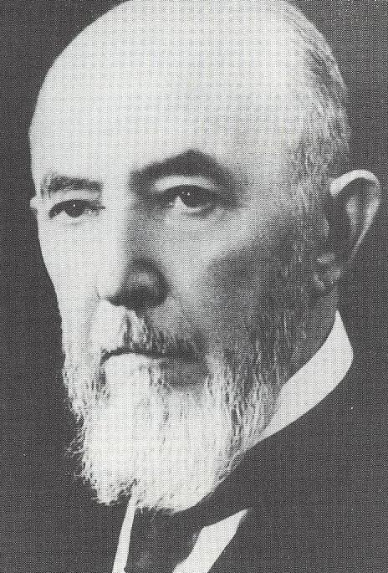
1912-RADIUM INSTITUTE OF PARIS
The renowned Pasteur Institute and the University of Paris founded the Radium Institute in 1912.
It was divided into the CURIE PAVILION
under Marie Curie and the PASTEUR PAVILION under Claude Regaud.
Regaud and his school (A. Lacassagne, Monod, H. Coutard ) exerted an enormous influence on cancer research.
They emphasized the experimental side of radiology, particularly “radiobiology” a term introduced by Regaud .
Established optimal dose rules and the concepts of protraction and fractionation.
Developed principles and treatment techniques for cancer of the cervix (Paris technique) .
Claude Regaud
1870-1940
Notes:
The renowned Pasteur Institute and the University of Paris in 1912
founded the Radium Institute of Paris….READ SLIDE….
Regaud’s investigations demonstrated
that prolonged low radium dose would kill sperm cell
But would not harm the interstitial tissue.

Slide 10
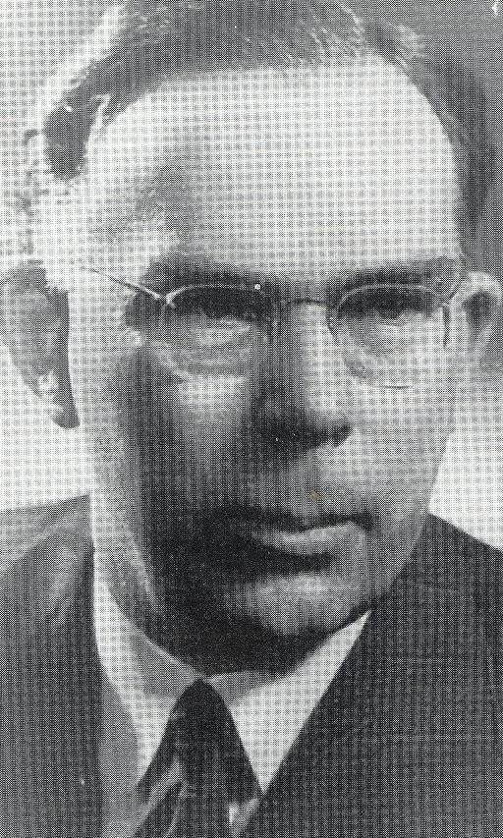
1933-HOLT RADIUM INSTITUTE OF MANCHESTER
Holt Radium Institute was founded in 1933 by the fusion of two much older hospitals, the Christie Hospital and the Radium Institute in Manchester.
Ralston Patterson, built a team of physicists and clinicians (his wife Edith, Margaret Tod, W. J. Meredith and Herbert Parker), who brought the Holt Radium Institute to the forefront of therapeutic radiology. Some of the school’s contributions are:
Standardized treatment for the same type of tumor
Introduced randomization of patients for scientific comparison by clinical trials
Introduced rules for interstitial radium implantation with dose tables which allowed more accurate dosimetry (Paterson-Parker tables))
A radium system for intracavitary treatment of cancer of the cervix (Manchester System); and the introduction of points A & B for dose specification in roentgen units.
Ralston Paterson
1897-1961
Notes:
After WWI, Continental Europe was devastated
and the center of scientific activity moved
to Great Britain and the United States.
The Holt Radium Institute was founded in 1933
by the fusion of two much older hospitals,
the Christie Hospital and the Radium Institute of the district of Manchester.
Ralston Patterson the first clinical director,
brought the Holt Radium Institute to the forefront of therapeutic radiology
attracting students from around the world. His contributions are numerous
He standardized treatments for the same type of tumor.
He pioneered the randomization of cases for scientific comparison by clinical trials.
He developed with his associates a radium dosage system for intracavitary treatment of cancer of the cervix
He standardized the rules of radium implantation with dose tables which allowed more accurate dosimetry.

Slide 11
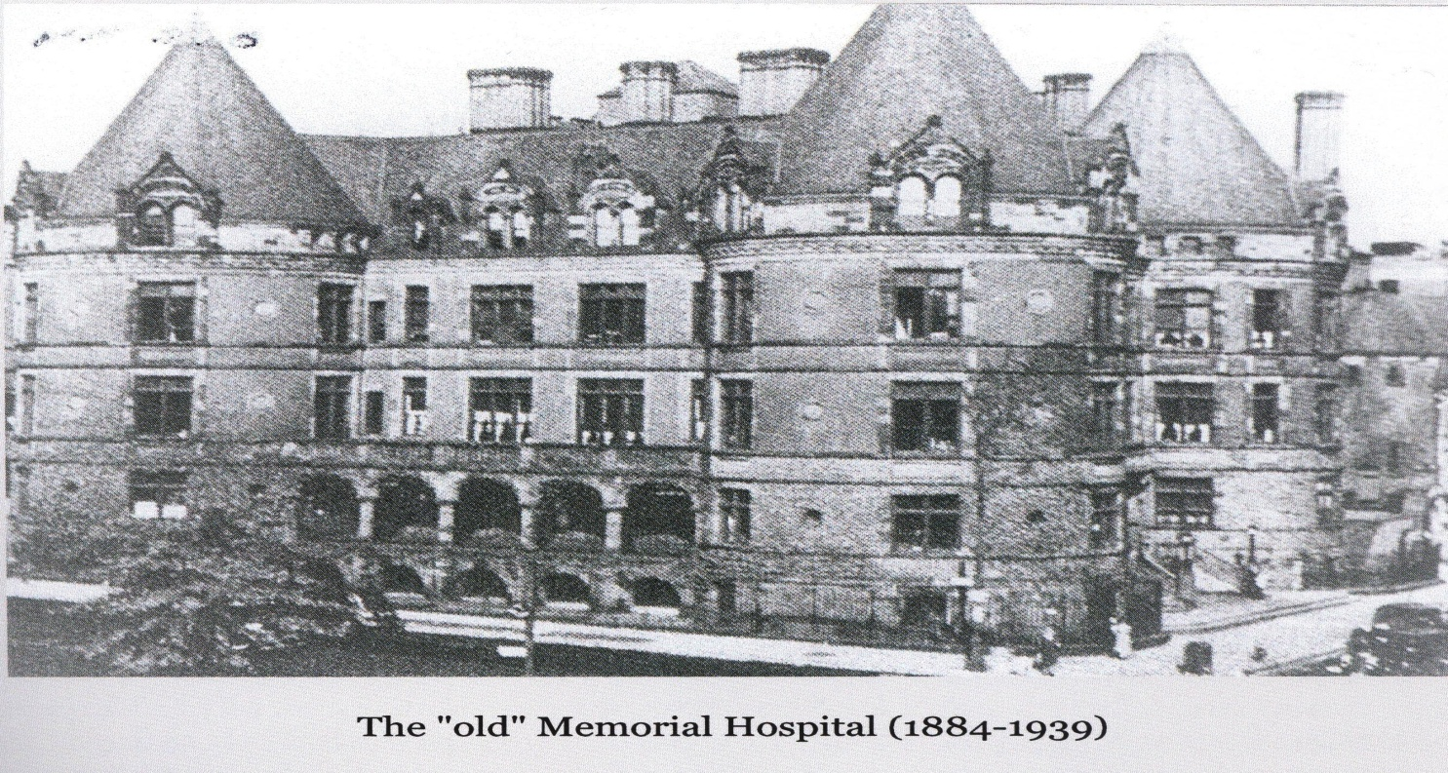
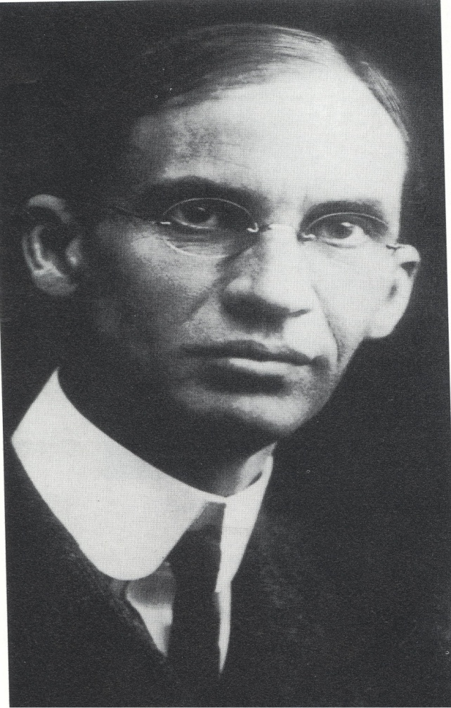
1915-MEMORIAL HOSPITAL OF NEW YORK
In 1915, James Ewing, professor of Pathology at Cornell University Medical Collage became the first director of MH, transforming it from a General Hospital into a leading Cancer Hospital (Memorial Hospital for Cancer and Allied Diseases, known informally as the Radium Hospital or The Bastille.)
Henry Janeway was appointed as the first Director of the newly created Radium Department
Notes:
READ SLIDE

Slide 12
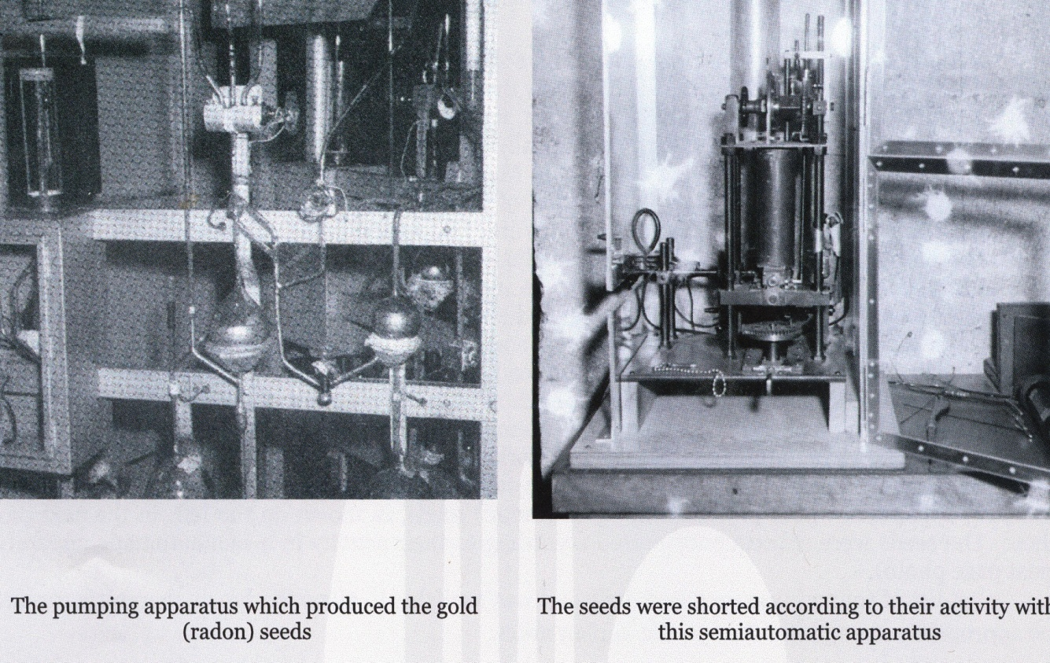
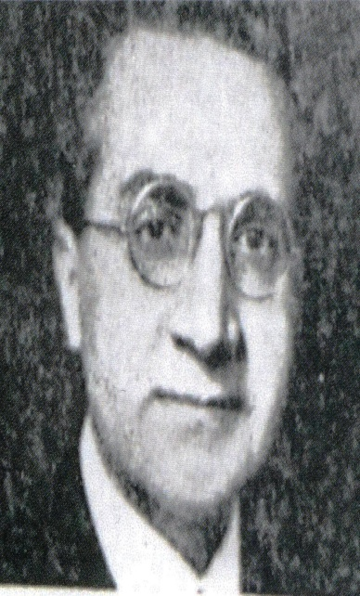
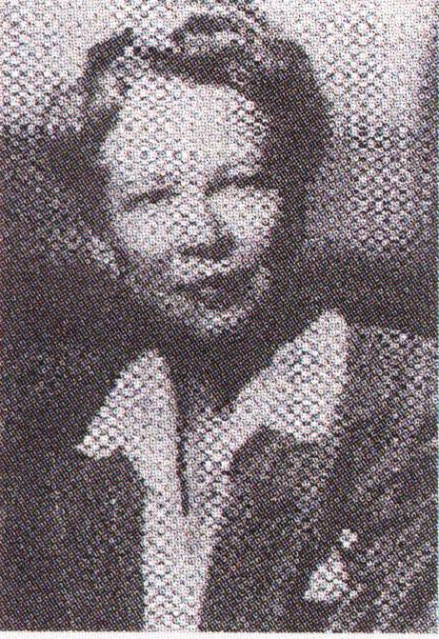
MEMORIAL HOSPITAL OF NEW YORK
In 1915, William Duane, Professor of
Physics at Harvard University, installed a
model of his radium extraction and
purification plant at MH to produce
radon seeds for therapeutic use.
In 1915, Henry Janeway appointed Gioacchino Failla in charge of the radon plant, and in 1919 as director of the new Physics Department. The same year Edith Quimby joined as Failla’s assistant.

Slide 13
1916-AMERICAN RADIUM SOCIETY (ARS)
On October 26, 1916, in Philadelphia, a new association, the American Radium Society was established by oncologic surgeons, gynecologists, radiologists and pathologists concerned with the treatment of cancer.
The aims of the society were declared to be “the promotion of the scientific study of radium, its physical properties, and its therapeutic application.”
The ARS was a model of interdisciplinary collaboration from its inception.
William Aikins (1859-1924) of Toronto, was elected as the first President.
Notes:
READ SLIDE

Slide 14
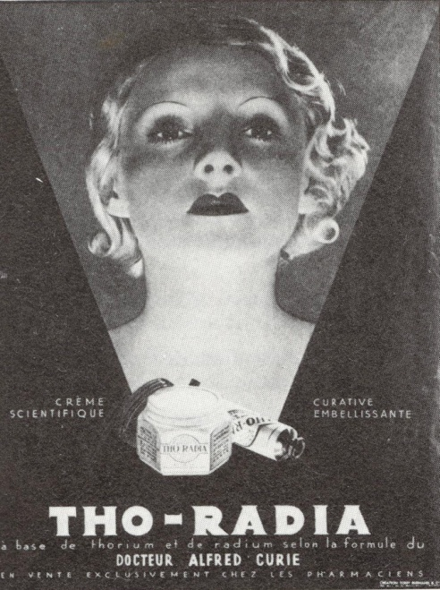
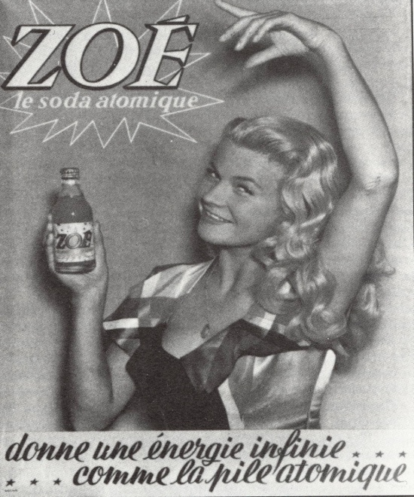
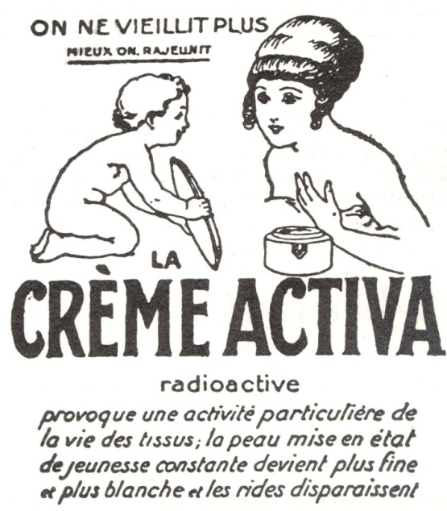
Opportunistic uses of Radium
Given the chance people will often misuse technology and create an enormous amount of mischief. This was the case with radium too! Radium was used in creams, shampoos, toothpastes or as a beverage, to prolong life and prevent aging!.
Notes:
READ SLIDE

Slide 15
1934-AMERICAN BOARD of RADIOLOGY (ABR)
The ABR was formed through the efforts of ARS, ACR, and RSNA and incorporated in Washington in January 1934 “to protect the public from irresponsible practices and to preserve the dignity of qualified professionals”. Since its inception in 1934 the ABR has issued more than 65,950 certificates in several subspecialties, that at times were very confusing.
Since 1994 the certificates are issued, in Diagnostic Radiology (and various subspecialties), Radiation Oncology and Radiological Physics, time limited (10 years) requiring recertification.

Slide 16
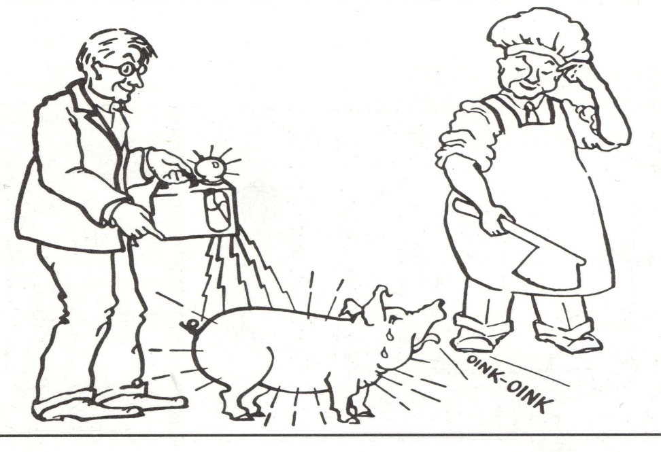
Recognition of Radiation Hazards
In the 40’s and 50’s, health professionals and public, began to recognize and be concerned with many aspects related to the use of radium, such as:
    Harmful effects of radium exposure
      Frequent radium accidents resulting in disastrous effects
Radium source construction and integrity issues
Laborious radium dose calculations
Lost radium sources frequently
ended up in incinerators, trash
water or down drains, but one
missing source was located inside
a pig!

Slide 17
CYCLE ONE CONCLUSIONS
During this period radium work was done in several “Radium Therapy” centers in Europe and North America.
Radium based techniques were developed for surface, interstitial and intracavitary irradiation.
Radiation physics departments were established that steadily contributed to the science of radiation therapy and specifically brachytherapy.
Various dosimetry systems were developed to calculate radiation dosages and distribution of radioactive sources, including the Paterson-Parker System in Europe and the Quimby System in the United States.
By the end of the first half of the 20th century, however, spectacular technical developments in the field of external beam therapy; significant improvements in surgical techniques and anesthesia; and professional concern regarding the harmful effects of radium exposure
Resulted in a declining interest for Brachytherapy and a marked decline
in its utilization.
Notes:
READ SLIDE

Slide 18
CYCLE TWO (1950-PRESENT)
Brachytherapy’s Renaissance
Many radiation workers felt that the disadvantages of radium required the investigation of alternative radionuclides for clinical use, that became possible only with the development of nuclear reactors. Production of artificial radionuclides resulted in a variety of commercially available sources for brachytherapy.
By the 1980’s, radium and radon had been almost completely replaced by sources such as Cesium-137, Cobalt-60, Iodine-125 and Iridium-192.
Notes:
The development of nuclear rectors allowed the investigation of new safer radionuclides for clinical use. Thus modern brachytherapy started with the atomic era and the development of substitute sources for radium and radon.

Slide 19
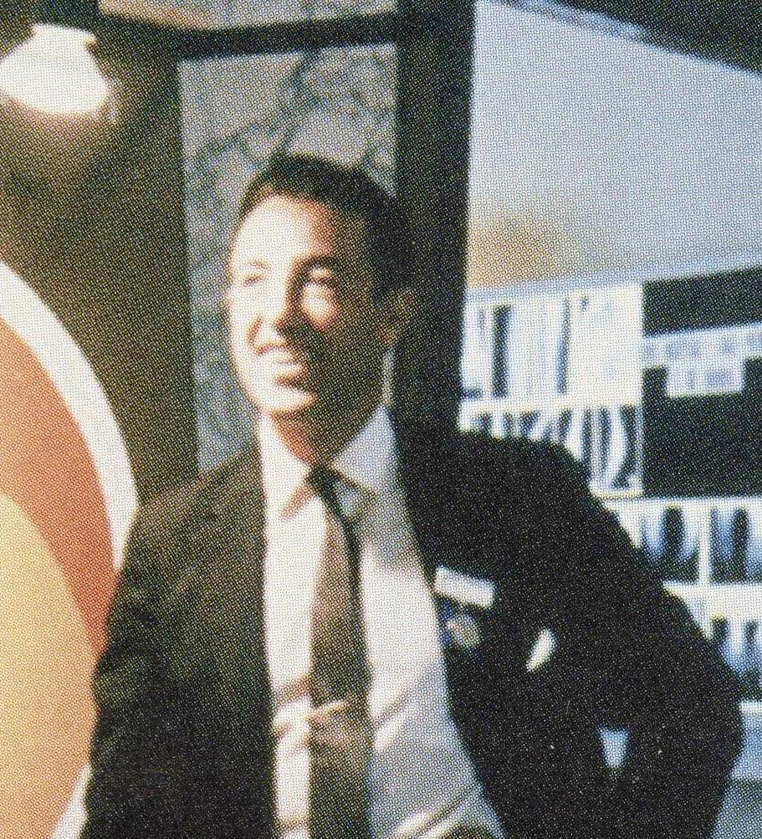
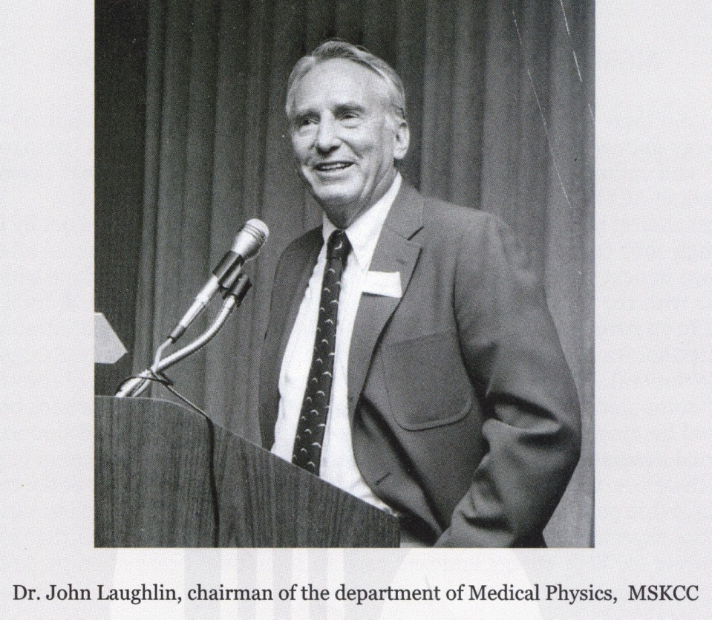
TWO EXCEPTIONAL PEOPLE AT MH
Many of the modern brachytherapy concepts and techniques were developed at MSKCC because of the efforts of these two scientists; and had a major impact on the practice of brachytherapy in North America and the rest of the World.
In Brachytherapy
In Medical Physics
Ulrich Henschke, MD, PhD
Notes:
Many of the events of the second half of the 20th century took place at MSKCC and the pioneering brachytherapy techniques developed and tested there because of the efforts of these two scientists had a major impact on the practice of brachytherapy in the United States and the rest of the World.

Slide 20
HIGHLIGHTS OF THE SECOND PERIOD
Research and development of artificial radionuclides as alternative to radium and afterloading techniques
Development and clinical applications initiated during this period mainly at MSKCC include:
Iridium-192 sources
Manual afterloading
HDR Remote Afterloading
Low energy sources
Computerized dosimetry
They will be discussed in more details in the following slides

Slide 21
AMERICAN ASSOCIATION OF
PHYSICISTS IN MEDICINE (AAPM)
CHICAGO, NOVEMBER 17, 1958
Many physicists in biology and medicine, among them W.K. Sinclair, J.S. Laughlin, and G.D. Adams, felt that had no professional identity and that a national organization might speak for the profession in a louder voice than all individuals singly.
Gail Adams was the first President, and the initial annual meeting was held near the time of RSNA meeting in Chicago in November.
This was the beginning of a remarkably strong educational, scientific, research , and professional association as we witness it today.

Slide 22
ARTIFICIAL RADIONUCLIDES
The development of nuclear reactors allowed the production and investigation of several safer radionuclides as alternative to radium, among them:
Gold-198 (1947)
Cobalt-60 (1948)
Iridium-192 (1954)
Yttrium-90 (1956)
Cesium-137 (1957)
Dr Henschke introduced Gold-198 seeds in 1954 at Ohio State University and Iridium-192 wires/seeds in 1955 at MSKCC, as substitutes for radium needles and/or radon seeds.
This represented an improvement over the use of radium and radon sources but radiation exposure still remained a major problem.
Notes:
READ SLIDE.

Slide 23
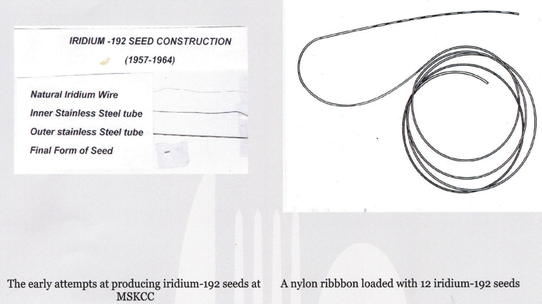
FIRST ATTEMPTS TO PRODUCE IR-192 SEEDS AT MSKCC (1957-1964)
Iridium-192 seeds were investigated because of their
Lower energy, Longer half-life and Large cross section
Notes:
Iridium-192 seeds were investigated because, compared with radon seeds, had:
Lower energy, which made them easier to store, transport and facilitated radiation protection;
Longer half-life which allowed their use for longer periods; and a
Large cross section which made their activation in nuclear reactors faster and cheaper.
DESCRIBE SLIDE

Slide 24
COMPUTERIZED DOSIMETRY
1957- First report on computerized implant- The application of automatic computation methods to implant dosimetry was presented by Richard Nelson and Mary Lou Meurk (MSKCC)
1962- First application of computer dosimetry in conjunction with iridium-192 afterloading,-W. Siler (MSKCC)
By 1971, applications of computers in radiation therapy, included:
    Dose-time computations,
    Treatment planning for internal sources and for external beams,
    Teaching,
    Automation of machine control ,and
    Logging and retrieval of patients’ chart data.
Notes:
READ SLIDE

Slide 25
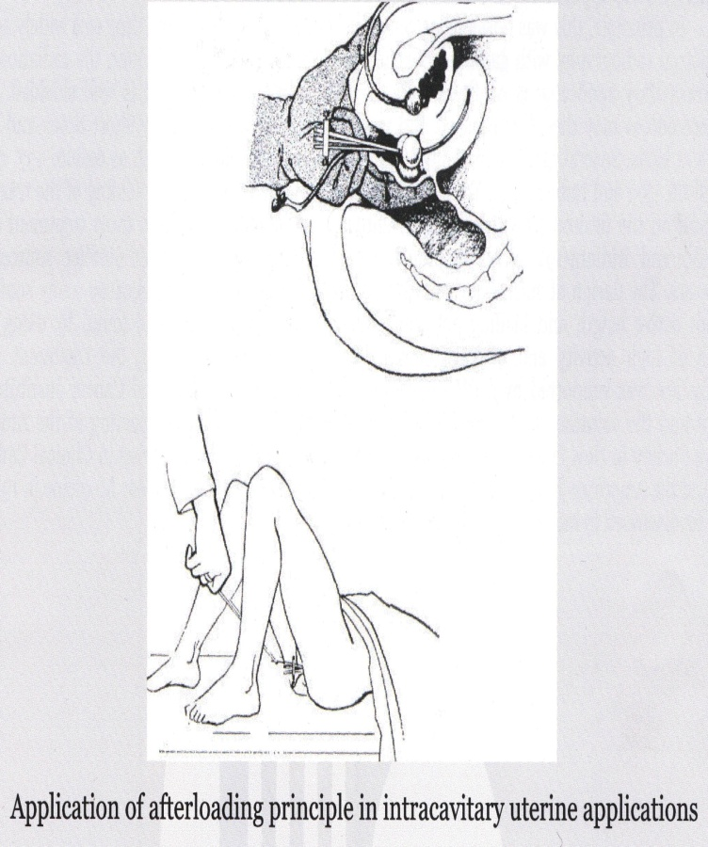
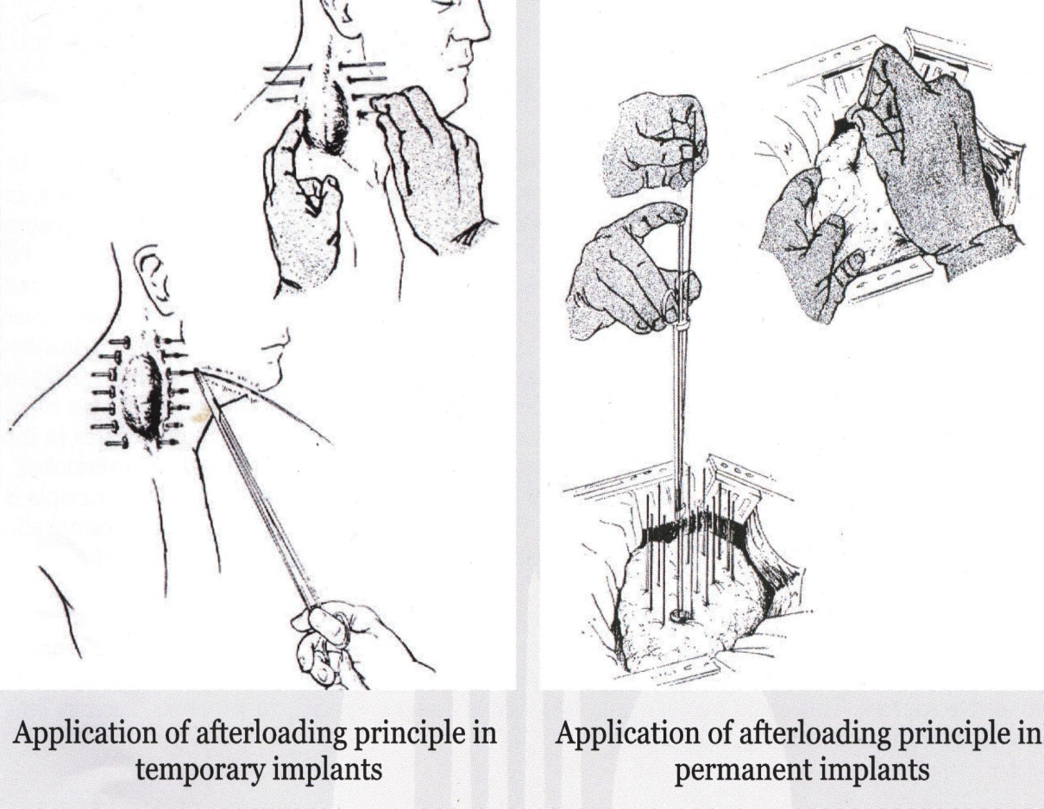
MANUAL AFTERLOADING
Manual afterloading was introduced, developed and refined in the late 50’s by Henschke, first at Ohio State University and then at MSKCC, in an attempt to:
Decrease radiation exposure to physicians, nurses, and other health workers of the institution, during a brachytherapy procedure .
The three sketches below show the characteristic steps of afterloading technique:
This concept was presented for the first time at the 10TH International Congress of Radiology, in Montreal in 1962.
Notes:
READ SLIDE

Slide 26
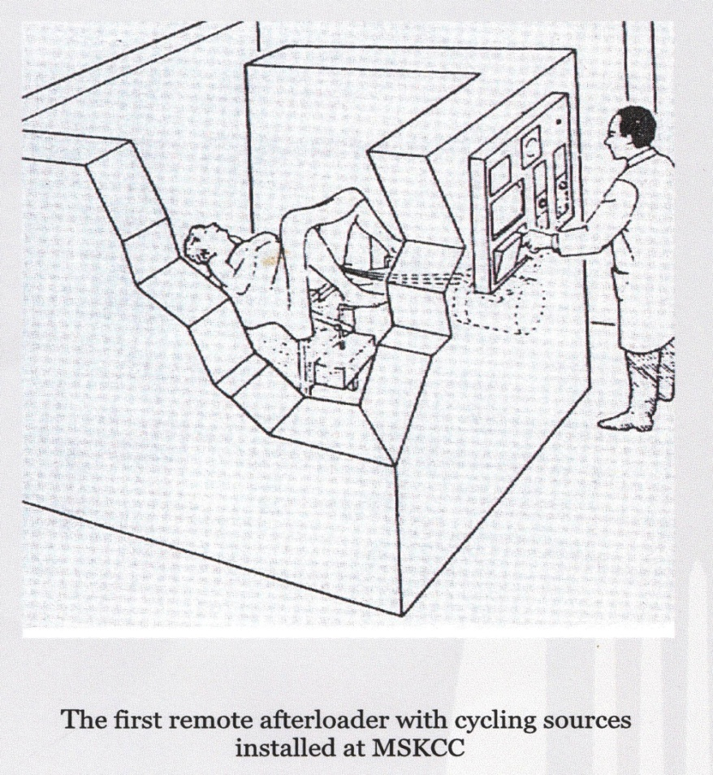
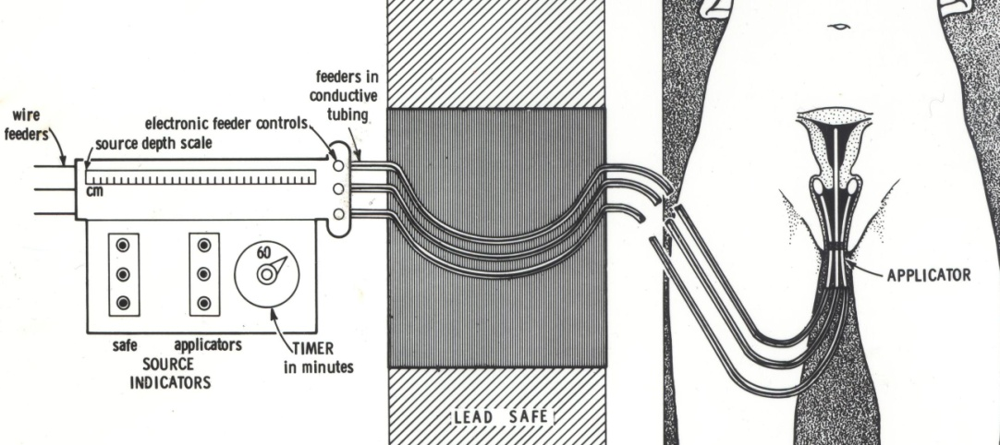
HDR REMOTE AFTERLOADING
Remote afterloading, using small cobalt sources of high activity, moving back and forth to simulate sources of different longer active length, was proposed in 1964 (Radiology,1964), to:
Eliminate radiation hazards to health personnel,
Avoid long hospitalization, and
Decrease patient discomfort
Control panel
This HDR Remote Afterloader remained in use at MSKCC, from its installation in 1964 until 1979, when it was replaced by a commercial unit.
Notes:
Remote afterloading using small cobalt sources of high activity moving back an forth to simulate sources of different longer active lengths was proposed by our group at MH as an alternative to conventional radium applications , to eliminate radiation hazards to health workers and for the patient to avoid long hospitalization and discomfort.

Slide 27
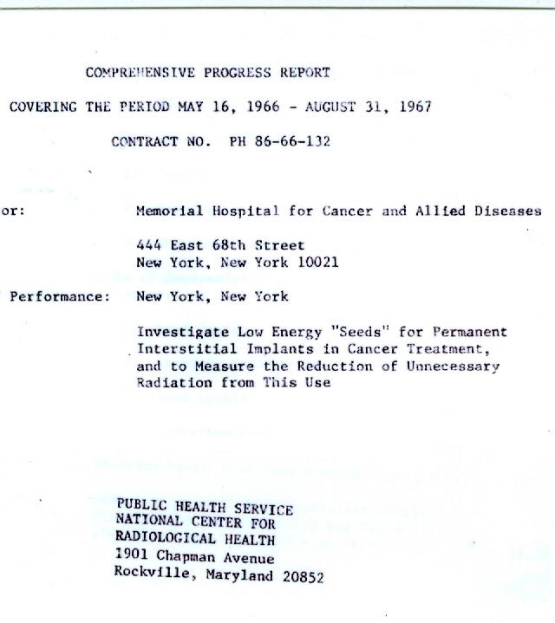
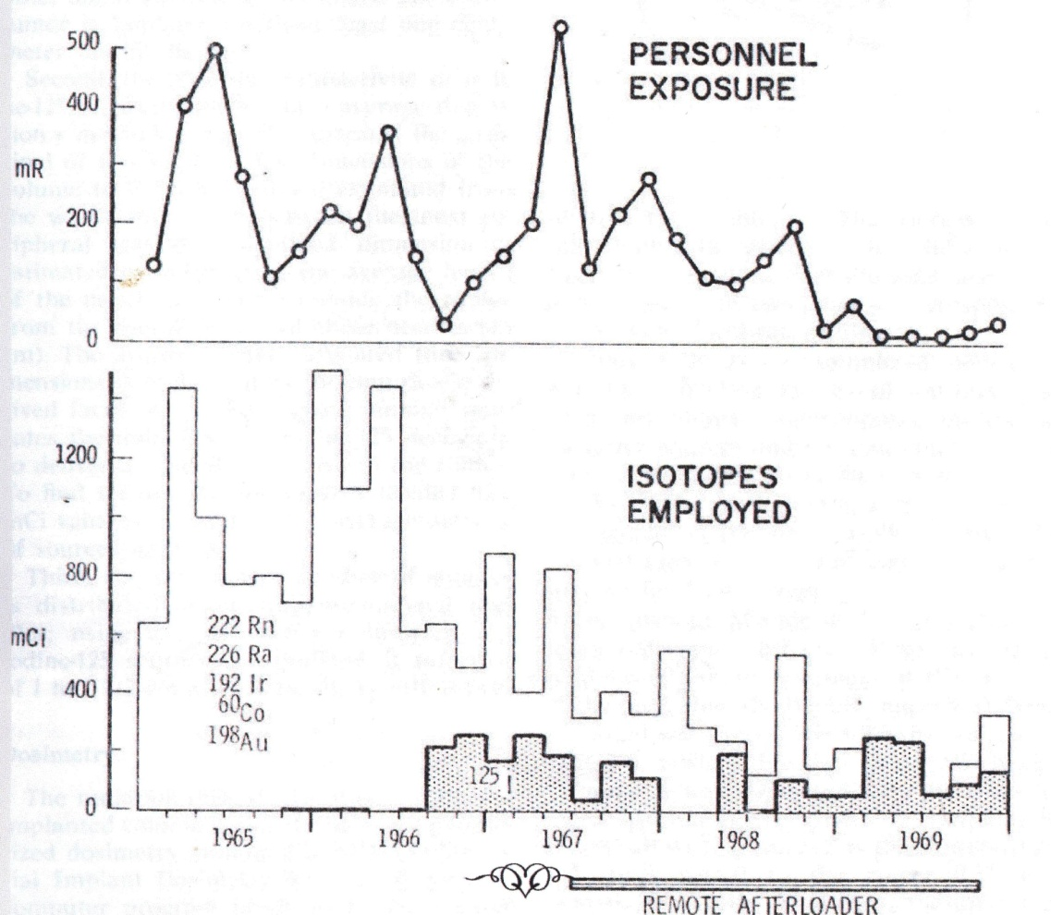
INVESTIGATION OF LOW ENERGY RADIONUCLIDES AT MSKCC (1966-1967)
Investigation of low energy radionuclides (Iodine-125, Cesium-131, and Xenon-133) was undertaken in 1966, to explore the possibility of further decreasing radiation exposure. From this experience we concluded that:
I-125 sources were a promising substitute for high energy sources; and radiation exposure to personnel was reduced considerably.
Notes:
READ SLIDE
During this study low energy radionuclides (Iodine-125, Cesium 131, and Xenon133 were investigated.
Because of cost considerations only iodine-125 was eventually investigated extensively
The graph on the right was included in the final report
and demonstrates the dramatic reduction in exposure to personnel at MSKCC,
following the introduction of remote afterloading and low energy iodine -125 seeds.

Slide 28
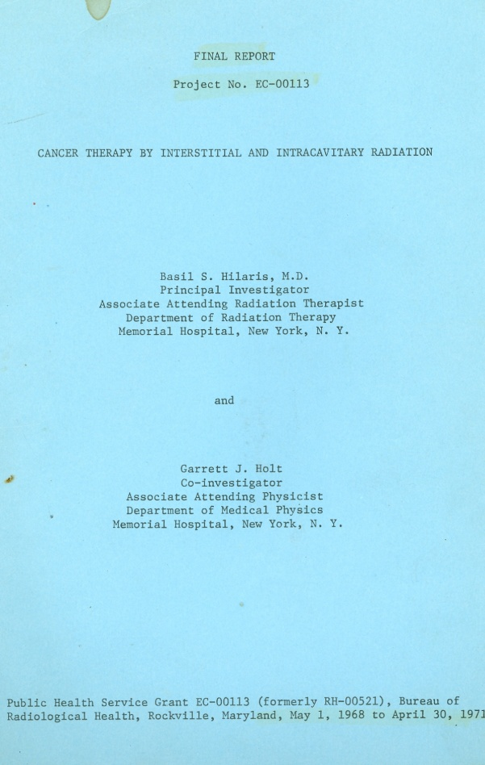
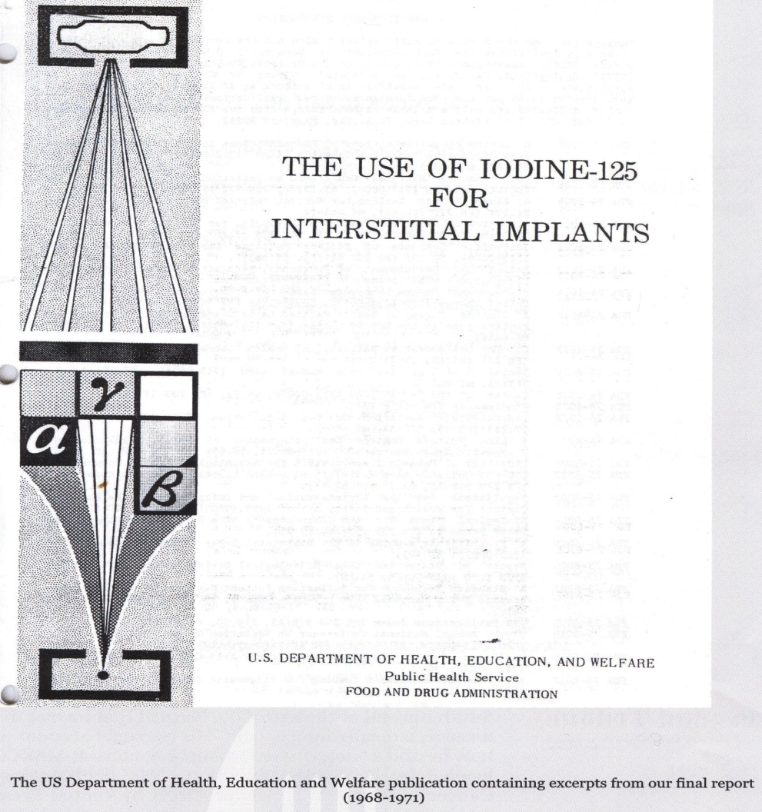
INVESTIGATION OF IODINE-125 AND HDR REMOTE AFTERLOADING AT MSKCC (1968-1971)
A more comprehensive investigation was conducted by Jean St Germain, Garrett Holt and Basil Hilaris in 1968. We investigated radiation protection issues; seed design, construction, calibration and dosimetric issues; and obtained clinical experience with I-125 ( in 234 pts) and HDR remote afterloading (in 196 pts).
The USDHEW response was as follows:
‘”The section on Iodine-125 appears to be significant for brachytherapy;
The section on HDR remote afterloading is not, because the traditional techniques with radium are already well established and very effective”.
Notes:
READ SLIDE

Slide 29
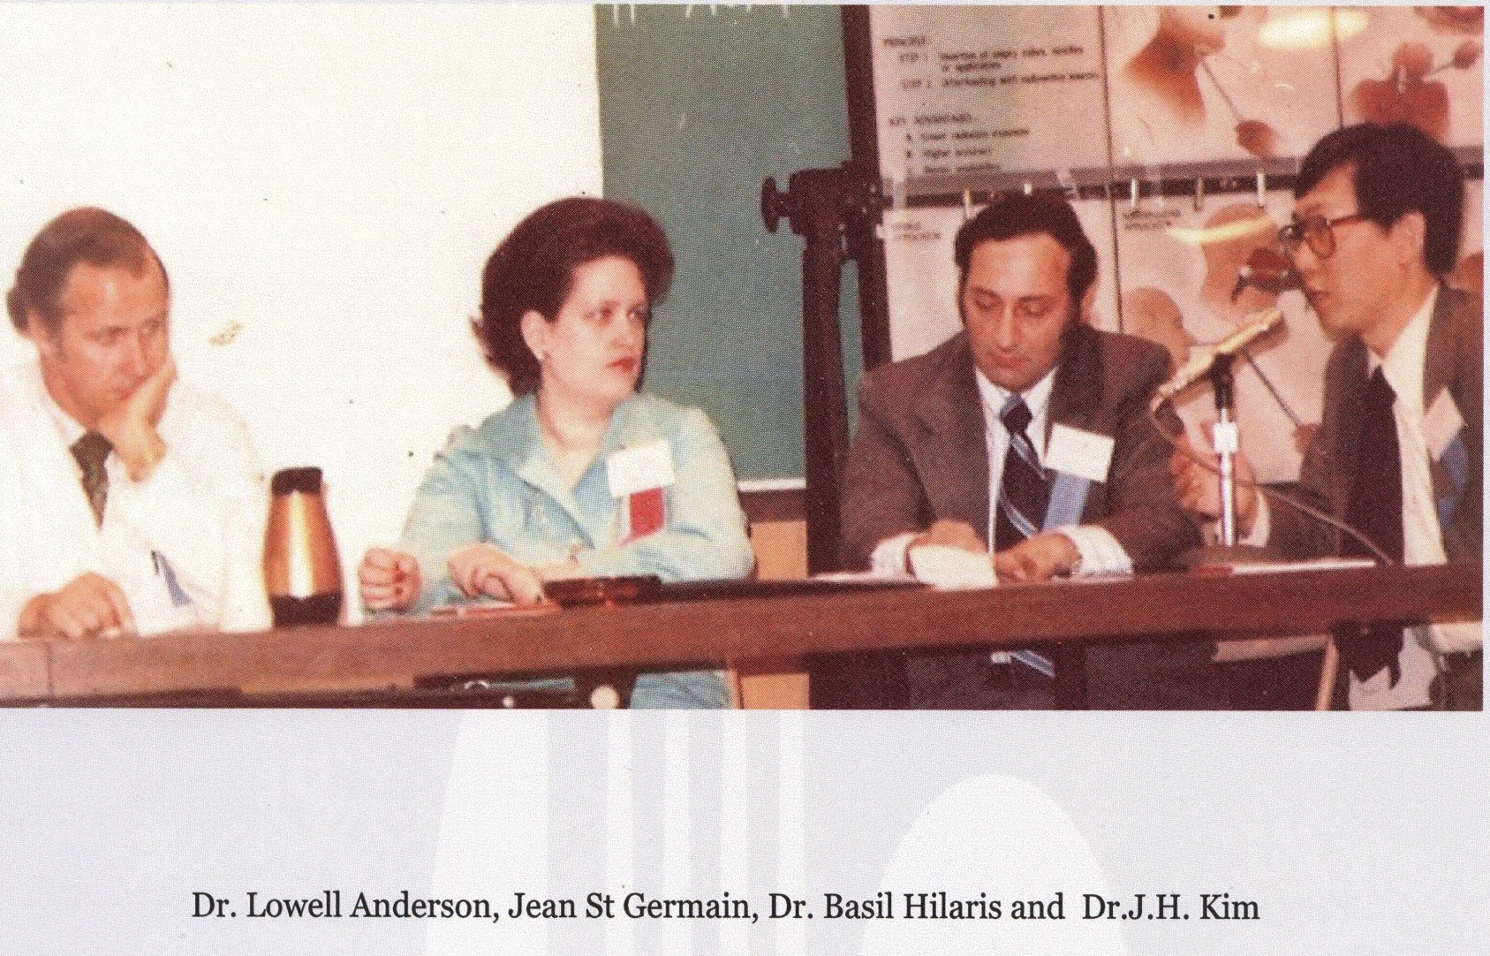
The Working Team in the 70’s

Slide 30
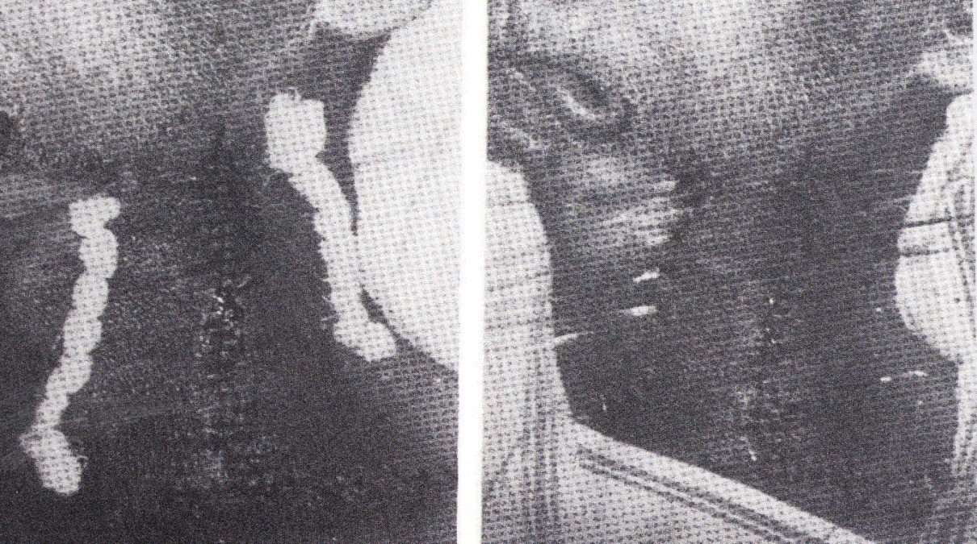
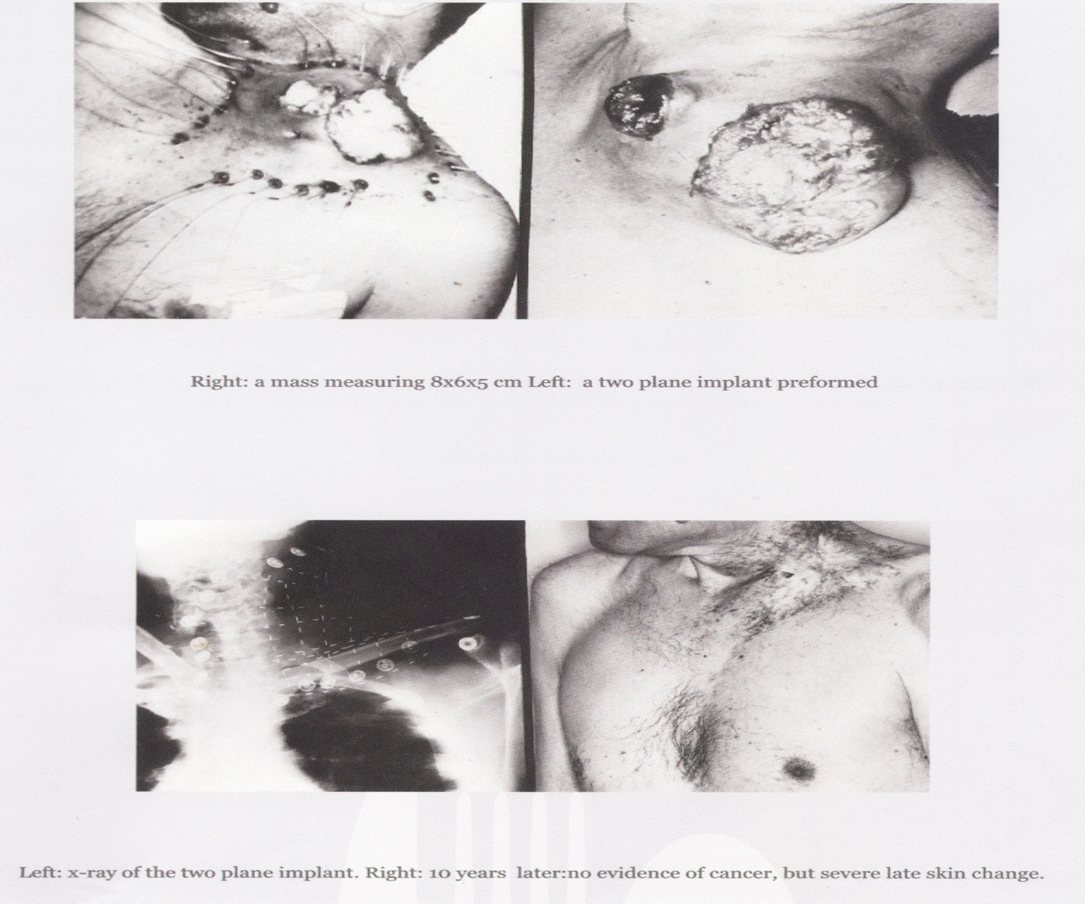
AFTERLOADING IN H&N CANCER
The role of brachytherapy in H&N cancer was reestablished after the introduction of afterloading techniques and artificial radionuclides.
The first postoperative afterloading H+N implant, using Gold-198 seeds, was performed by Henschke at Ohio State University in 1953.
Notes:
A patient previously treated by surgery in 1951 for cancer of the lower gum, recurred in 1953 with large nodes in the left neck. When the operating surgeon realized that he could not perform complete resection, Henschke suggested suturing stainless steel wires through the neck nodes. Three days later the wires were used to pull nylon tubes loaded with gold-198 seeds into position in the nodes. The first procedure was done in a local hospital by the surgeon, while the afterloading was done by Henschke at Ohio State University Hospital

Slide 31
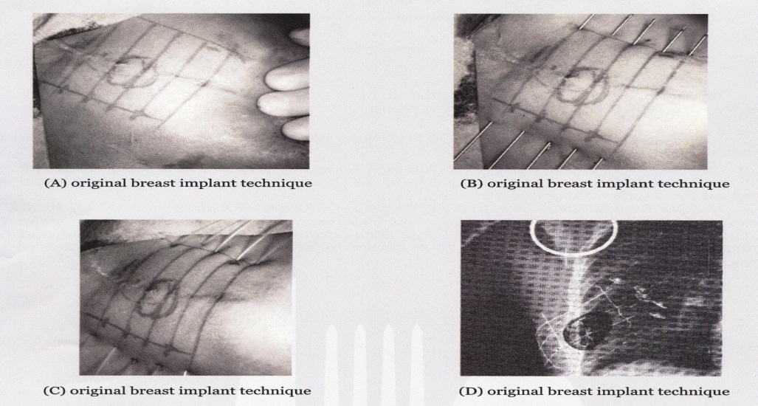
AFTERLOADING IN BREAST CANCER
Manual afterloading of Ir-192 in conjunction with conservative surgery ((lumpectomy) revived interest in brachytherapy.
Notes:
Harris et al in 1980 reported 5 year local control from the Joint Center: T1=96% and T2=90%
Pierquin in 1983 reported 10 years local control in 408 patients from Creteil Institute: T1=92%, T2=91% and T3=85%.
DESCRIBE SLIDE

Slide 32
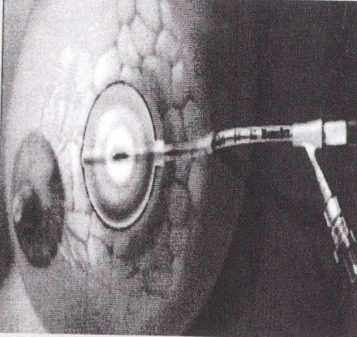
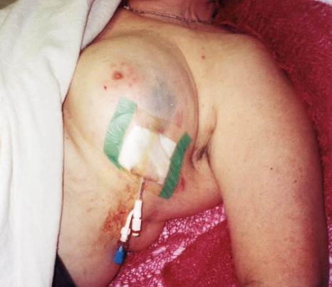
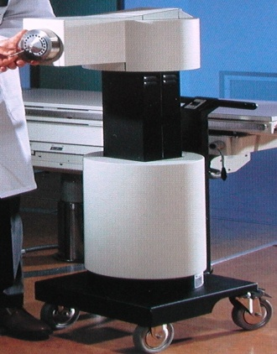
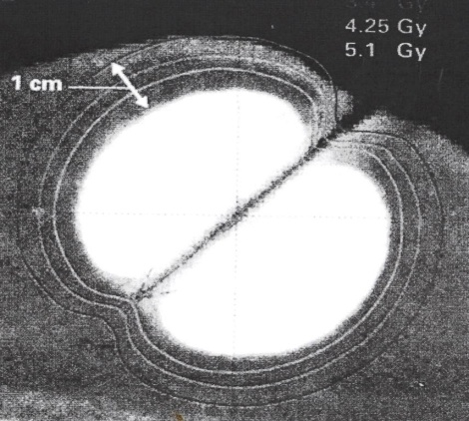
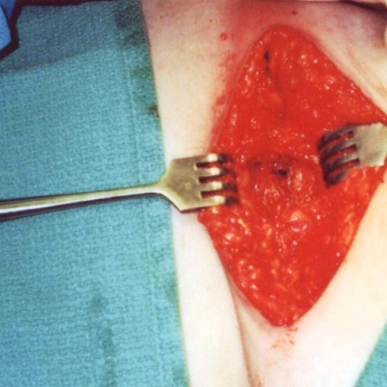
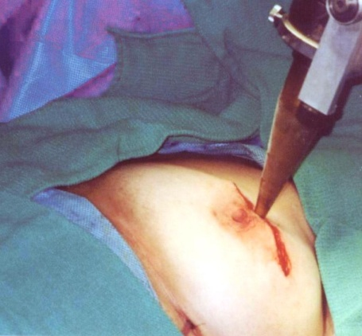
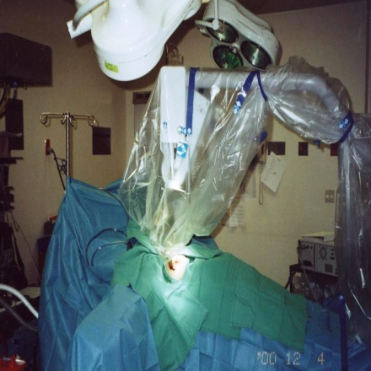
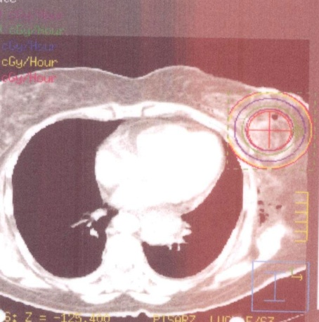
MODERN AFTELOADING TECHNIQUES
IN BREAST CANCER
ACCELERATED PARTIAL BREAST IRRADIATION (APBI)
(a total dose of 34 Gy, twice a day x 5 days on an outpatient basis)
INTRAOPERATIVE BREAST RADIATION THERAPY (IORT): a single dose of 10-20 Gy/30 minutes, at the end of lumpectomy
INTRAOPERATIVE BREAST RADIATION THERAPY (IORT)
(a single dose of 10-20 Gy is delivered in 30 minutes)
Notes:
The acceptance of “lumpectomy” as the treatment of choice in early breast cancer, allowed the use of limited irradiation to the tumor site in conjunction with ERT.
ACCELERATED PARTIAL BREAST IRRADIATION (APBI): refers to treatment of the lumpectomy cavity with a predetermined margin without irradiating the whole breast. It is an alternative to whole breast irradiation in patients with early breast cancer.
These pictures show the MammoSite Radiation therapy system, consisting of a balloon catheter which can be inflated to sphere 5-6 cm in diameter. The balloon is attached to a thin catheter, a portion of which is remains outside the breast. The treatment is delivered on an outpatient basis, after the catheter is connected to an HDR unit. It is given twice a day for 5 days, for a total dose of 34 Gy. Computerized treatment planning is CT based.
INTRAOPERATIVE BREAST RADIATION THERAPY (IORT) uses a miniaturized electron generator and accelerator (PRS-INTRABEAM) which produces soft x-rays.. A spherical applicator is introduced into the lumpectomy cavity and a single dose of 10-20 Gy is delivered in 30 minutes.

Slide 33
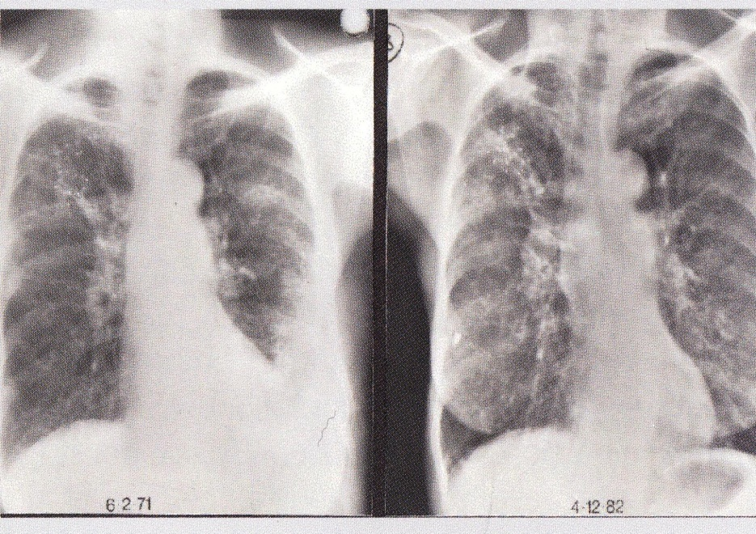
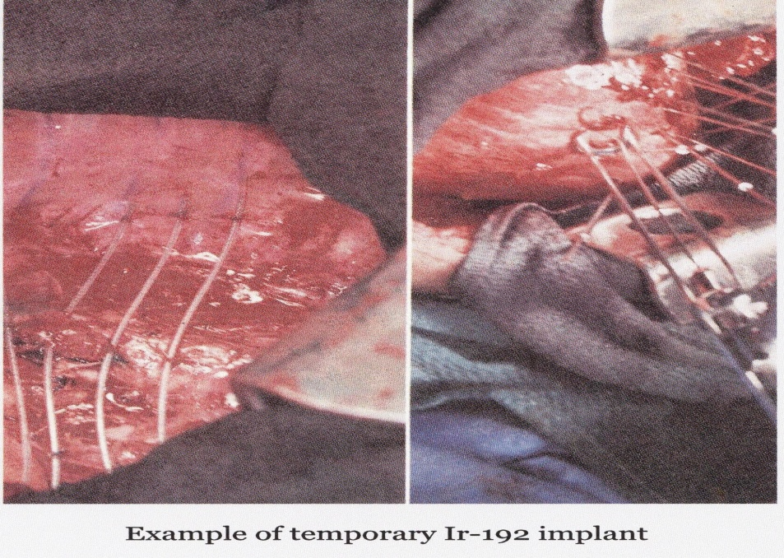
AFTERLOADING IN LUNG CANCER
Example of permanent I-125 implant
The largest experience with permanent I-125 and temporary Ir-192 implants (in over 1000 pts) was accumulated at MSKCC during the 60’s to 80’s. The long term results for selected patients with limited pulmonary reserve who could not tolerate resection (stage I and II) were promising with an overall 5-year survival of 32%.
The availability of newer techniques, including IMRT, improved dosimetry, and the integration of chemotherapy have almost completely replaced BRT today.

Slide 34
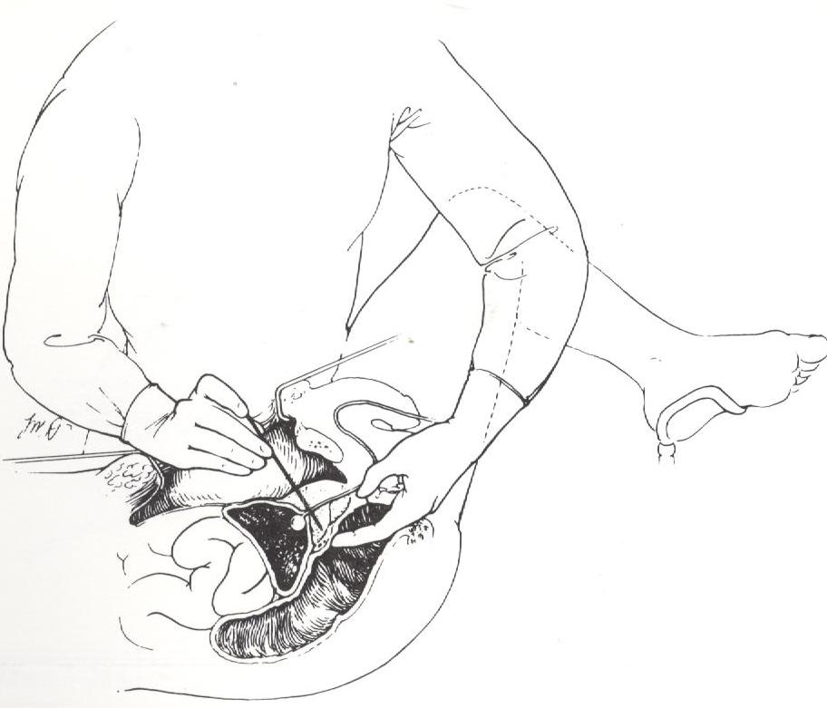
AFTERLOADING IN PROSTATE CANCER
In 1969 the Urology and Brachytherapy service at MSKCC begun a collaborative study to investigate I-125 in conjunction with pelvic lymphadenectomy for the treatment of cancer of the prostate, as an alternative to radical prostatectomy. Several hundred patients were treated and the following conclusions were drawn from this experience
Patients with positive nodes would soon develop distant (bone) metastases.
Small tumors, localized to prostate were optimal candidates.
Tumors that were treated to a minimum of 160 Gy were better controlled, than tumors receiving a lesser dose.
Notes:
The prevailing attitude in the first half of the 20th century was that cancer of the prostate could not be adequately treated by radiation. In the late 60’s Dr George, Dr Bagshaw, Dr Del Regato and Dr Bennett published encouraging results of treatment with the newly emerging megavoltage external beam radiation. In 1951 renewed interest in brachytherapy was aroused by the interstitial injection of radioactive colloidal gold into the prostate by Dr. Flocks at Iowa's State university. The technique was not, however, widely used.READ SLIDE The technique was difficult to learn and misapplications resulted in its decline by early 80’s. Credit belongs to Dr Ragde and Dr Blasko in Seattle, who in 1987 adopted transrectal ultrasound and computer technology to I-125 prostate brachytherapy.

Slide 35
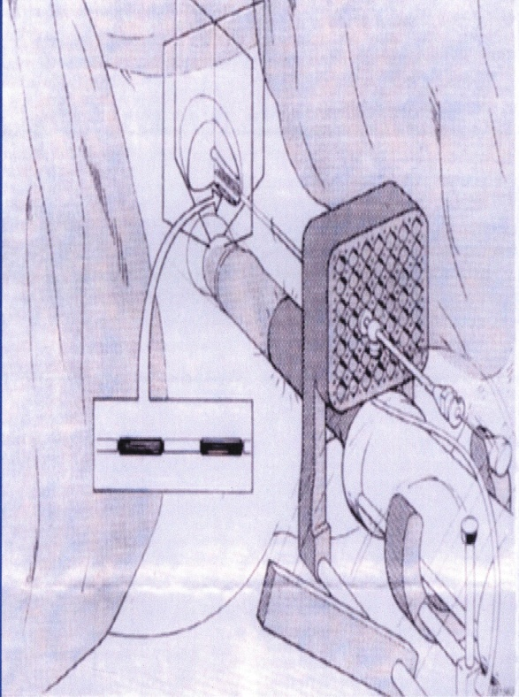
Modern afterloading techniques in prostate cancer
The original retropubic manual afterloading technique was difficult to learn and misapplications were frequent resulting in its decline by the early 80’s.
The adaptation of the transperineal approach in 1987, in combination with transrectal ultrasound, CT or US pretreatment planning optimization and prefabricated templates resulted in the reestablishment of brachytherapy (Manual or HDR) in the treatment of cancer of the prostate.
Modern manual afterloading technique

Slide 36
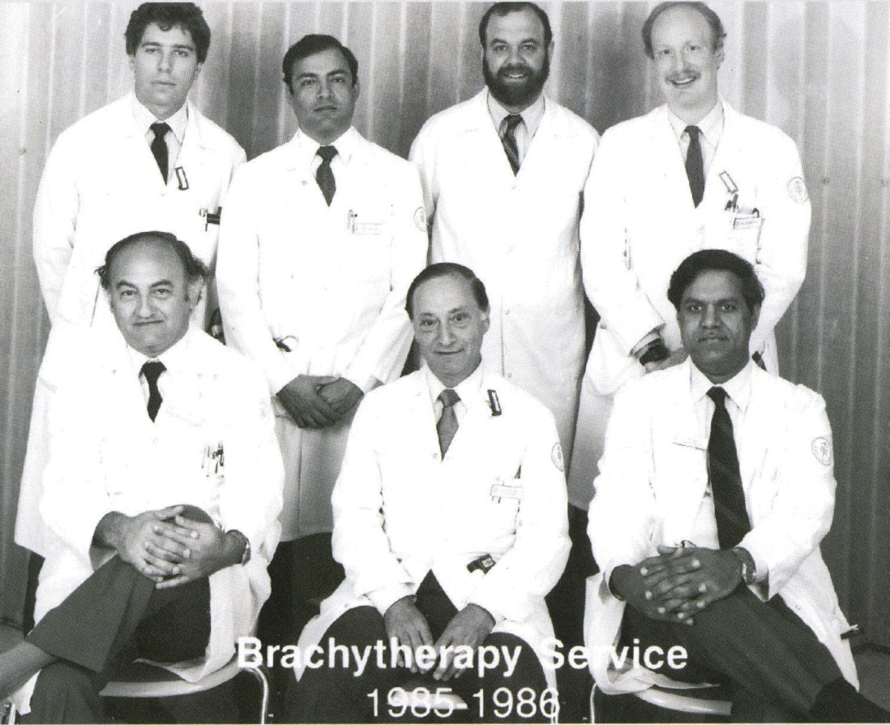
1979-BRACHYTHERAPY SERVICE AT MSKKC
The first modern BRT service in the USA was established on July 1st, 1979 at MSKCC. Many members of the service had subsequently very successful careers. You will recognize the following names:
Dr D. Nori
(NYH),
Dr B. Vikram
(IAEA & NCI),
Dr. S. Nag,
Dr. A. Martinez,
Dr. L. Harrison
(President of ASTRO),
Dr. M. Zelefsky
(editor of Brachytherapy Journal
Chief of Brachytherapy Service)
From left: Sitting: Drs. H Brenner, B. Hilaris, D. Nori.
Standing: Drs A.Tankenbaum, L. Linares, a surgical resident, Dr D. Greenblatt

Slide 37
AMERICAN BRACHYTHERAPY SOCIETY
In 1978 Syed and sixty-seven other physicians founded the Endocurietherapy Society in California.
By 1985, the membership had grown to 395 practicing radiation oncologists, medical physicists and radiation biologists throughout the United States.
In 1997 the society was renamed American Brachytherapy Society. Today the society is broadly accepted with a significant increase in its membership and the quality of its members; significant clinical and research contributions; and successful efforts in continuing education by the establishment of “schools” in head & neck, breast and Gyn brachytherapy
Notes:
In 1978 Nisar Syed and sixty-seven other physicians founded the American Endocurietherapy Society in California.
By 1985 the membership had grown to 395 practicing radiation oncologists, medical physicists and radiation biologists throughout the USA.
In 1997-the society was renamed American Brachytherapy Society.
The society’s aims were “to provide a forum for practicing radiation therapists,
hyperthermia oncologists, physicists and radiation biologists,
for the exchange of ideas and new developments;
to promote clinical and laboratory research;
and to study the socio-economic aspects of brachytherapy”
First President Dr Harvey Frey (1978),
Dr. David Neblett (1979)
Dr Aaron Fingerhut (1980)
Dr Paul Chan (1981)
5^{th ?????}
6th Dr Thomas Gates (1983)
7th Dr Nisar Syed (1984)
8th Dr Don Goffinet (1985)
The first eight presidents were from the West Coast
but in 1986 I was elected as the first president from the East Coast.
9th Dr Basil Hilaris (1986)

Slide 38
CYCLE TWO CONCLUSIONS
THE SECOND 50 YEARS OF BRACHYTHERAPY
Modern brachytherapy, properly applied, contributed to improved treatment techniques and advanced the cause of cancer control.
New radionuclides with lower energy, commercially produced HDR units, optimization of BRT planning, and ultrasound/CT based real-time planning became available.
Computer technology and the resulting ability to produce very accurate three dimensional radiation dose distributions within the patient; and standardization of brachytherapy techniques, allowed for more uniform practice and better use of integrated treatments.
This success story of brachytherapy was driven
By extensive technological developments; the increased number of physicians and physicists practicing brachytherapy, and the interest generated in other ontological specialties. And it is reflected in the considerable brachytherapy literature; the formation of the American Brachytherapy Society; and its dedicated Brachytherapy Journal.
Notes:
In 1978 Nisar Syed and sixty-seven other physicians founded the American Endocurietherapy Society in California.
By 1985 the membership had grown to 395 practicing radiation oncologists, medical physicists and radiation biologists throughout the USA.
In 1997-the society was renamed American Brachytherapy Society
The society’s aims were “to provide a forum for practicing radiation therapists,
hyperthermia oncologists, physicists and radiation biologists,
for the exchange of ideas and new developments;
to promote clinical and laboratory research;
and to study the socio-economic aspects of brachytherapy”
First President Dr Harvey Frey (1978),
Dr. David Neblett (1979)
Dr Aaron Fingerhut (1980)
Dr Paul Chan (1981)
5^{th ?????}
6th Dr Thomas Gates (1983)
7th Dr Nisar Syed (1984)
8th Dr Don Goffinet (1985)
The first eight presidents were from the West Coast
but in 1986 I was elected as the first president from the East Coast.
9th Dr Basil Hilaris (1986)READ SLIDE

Slide 39
CYCLE THREE
THE SPECIALTY’S FUTURE
Today brachytherapy and medicine in general, face several impending risks, threatening its practice, such as:
Constant warnings about radiation overdoses, lack of safeguards, and software flows, resulting in more stringent regulation of medical radiation.
A fast-rising cost curve which must be dealt within our specialty.
An uncertain political outlook; it appears that treatment decisions in the future will be made by protocols with several layers of midlevel administrators.
Some steps can be taken right away, such as
Becoming more proactive in medical education.
Continue to minimize the invasiveness of brachytherapy procedures and
Reassessing risks, vs. benefits vs. cost
It is my strong belief, that Brachytherapy because of solidly developed medical and technical foundations, is the most suitable medical specialty for the implementation of the rapidly advancing technology including biotechnology, and even nanotechnology.
Notes:
READ SLIDE

